Slide 1



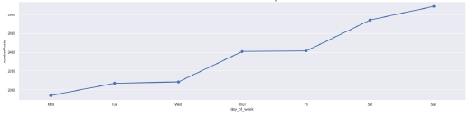

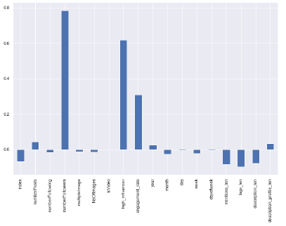



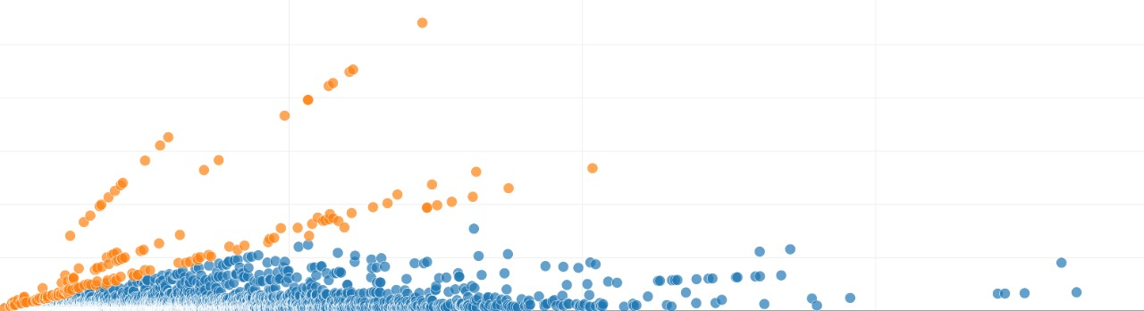



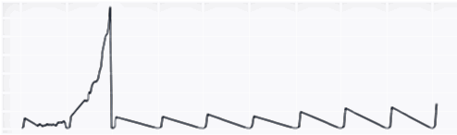
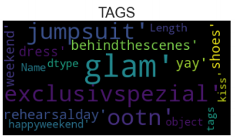
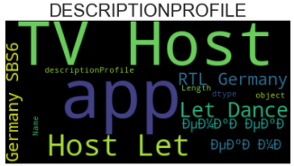
Analyze data containing information of nearly 1000 influencers and predict the number of likes a post will generate by understanding the marketing industry and engagement of small and big influencers.
Data Wrangling
Factors affecting number of likes
Discovering & Structuring
21 independent and 1 dependent features
16539 records
Target column – Number of likes
973 unique users
Instagram users posted more on weekends as compared to weekdays. Graph shows the upward trend when moving from Monday to Sunday.
Data Cleaning
Cleaning of extra spaces
Replaced null values with Zero
Differentiating date and time
Correcting year “1970”
Co-relation with Target:
Higher the number of followers, higher the number of likes they got
Profile with high engagement rate strongly affects the number of likes.
High influencers (more than 5 million followers) tends to get more likes.
Profile with large number of posts tends to get higher likes on new posts.
Users who have profile description longer might attract more likes on new posts.
Lengthier the post description, lesser the likes it receives.
Data Enriching
Extracting number of images posted
Hierarchy of dates
Extracting number of tags and mentions
Description length
Data Analyzing
Pivot tables and charts using excel
Machine learning and models using Python
More than 50% of data is missing for localization and 11% for website header
Only 4% of the users are high influencers.
98% of the data were single image post and 2% was post with multiple images.
Last recorded time stamp was 12 April 2017
Data Insights
Low influencer
High influencer
Instagram posts with single image were more and received higher number of likes
Engagement rate (x-axis) vs number of likes (y-axis) grouped by influencer
Word cloud for “tags” and “description profile”
There is a sudden hike in Instagram posts in April-May, 2017. A huge plummet from May, 2017
Single Image
Multiple Image

Slide 2
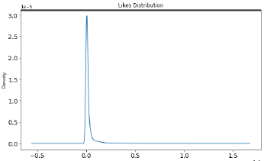
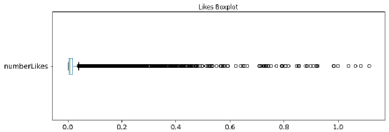
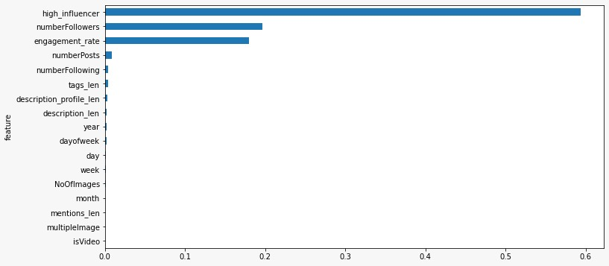

Approach for Model Building
Model
All the features in the dataset were bifurcated into Numerical , Categorical, Textual and Date category
11 additional features were generated from date features and textual features like mentions, tag, description and profile description
Because the target feature (Number Likes) was highly right skewed and contained many outliers, it was paramount to take the log of features to standardized the distribution and avoid biased result.
Split the data into training data (80 %) and validation data (20 %) using train test split to train with ML models.
Because of skewed data, we further used Stratified KFold (with 5 folds) to train and validate predictions.
To optimize models hyper parameter tuning was done.
Target Distribution (Instagram likes)
Base Line Model
Predicting post likes with mean values
1387.6 RMSE
Predicting using number of post
1850.09 RMSE
Boxplot (Outliers)
Machine Learning Model
Liner Regression (only numerical features)
57.21 RMSE
Liner Regression (categorical & numerical features)
57.20 RMSE
Analysis from Model
Decision Tree Regressor (Hyper Parameter Tuning)
18.56 RMSE
Decision Tree Regressor (Stratified KFold)
26.43 RMSE
Out of all the 11 models , we can vouch for XG Boost model as it showed the best prediction with least error considering the biasing factor.
To appreciate how engagement works for small and big influencers, majorly two variables stood. High influencer had higher number of likes because of higher number of followers but low small influencer had high engagement rate compared to high influencers.
Additional features drawn:
Number of images in each post, year, month, day, week, day of week, engagement rate, length of mentions, length of tags, length of description, length of profile description, high influencer
Gradient Boosting
LightGBM
26.43 RMSE
CATBoost
26.40 RMSE
XGBoost
23.34 RMSE
LightGBM Hyper Parameter Tuned
26.47 RMSE
LightGBM with tuned hyper parameter and learning rate
26.56 RMSE
The aforementioned graph ranks the importance of features in decreasing order
To get the best parameters for tuning, RandomizedSearchCV was triggered to get the best Permutation of parameters in least possible time. Further learning rate was set at 0.01.
Metric used – Root Mean Square Error (RMSE)
Note - All above value of RMSE are multiplied by 1000 for better readability
Team: D-tale, SIOM Nashik

